Slide 1
Advanced
Microsoft Word
Greenwich Continuing Education
Instructor: Rich Malloy
Tech Help Today
203-862-9411
malloy@techhelptoday.com
Notes:
Advanced Microsoft Word - Tables

Slide 2

Goal of the Course
To learn more about Microsoft Word
To learn how to do more in less time
To find out the best approaches for further learning
Notes:
Advanced Microsoft Word - Tables

Slide 3
Schedule
Five Monday evenings, two hours each, 7:30 – 9:20 pm
Each evening, approx. 30 minutes lecture, 80 minutes hands-on
Practice at home
Notes:
Advanced Microsoft Word - Tables

Slide 4
Your Instructor – Rich Malloy
Computer Consultant – Tech Help Today, Greenwich
Adjunct Professor, Norwalk Community College
Microsoft-certified Expert in Word 2002, certified Master in Microsoft Office XP
Former Editor in Chief, Mobile Computing
Notes:
Advanced Microsoft Word - Tables

Slide 5
References
Handouts
Suggested book:
  MS Word 2003 for Dummies, $19
Web sites:
  www.microsoft.com/office/word -- Official site
  http://word.mvps.org/ -- "Most Valuable Pros“
  http://office.microsoft.com/templates/-- Templates
  Google: “Word Help and How To” – Great help site
Notes:
Advanced Microsoft Word - Tables

Slide 6
Software Needed
A recent version of Microsoft Word:
  MS Word 97
  MS Word 2000
  MS Word 2002
  MS Word 2003 *
  MS Word 2007 – very different
Computer Lab uses Word 2007
Notes:
Advanced Microsoft Word - Tables

Slide 7

Buying Microsoft Word
Word 2003
  Not available anymore
Word 2007
  Current version
Notes:
Advanced Microsoft Word - Tables

Slide 8
Microsoft Office
“Suite” Includes:
  Word, Excel, PowerPoint, Outlook
Office 2003
  Not available anymore
Office 2007
  New: ~$350
Notes:
Advanced Microsoft Word - Tables

Slide 9
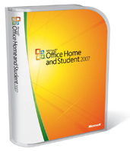
☞ Best Deal 
Microsoft Office 2007
for Students & Teachers
(includes Word, Excel, PowerPoint)
Staples: ~$150 !!
Notes:
Advanced Microsoft Word - Tables

Slide 10
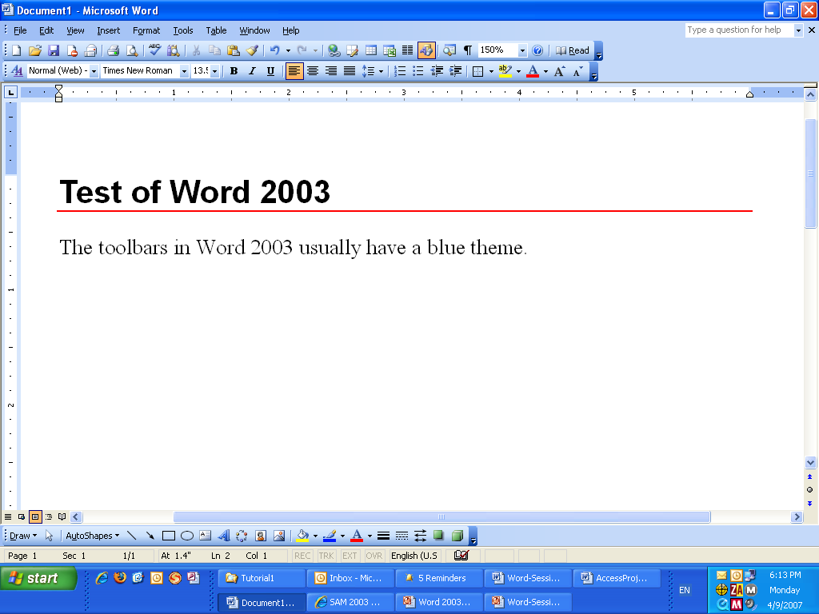

Slide 11
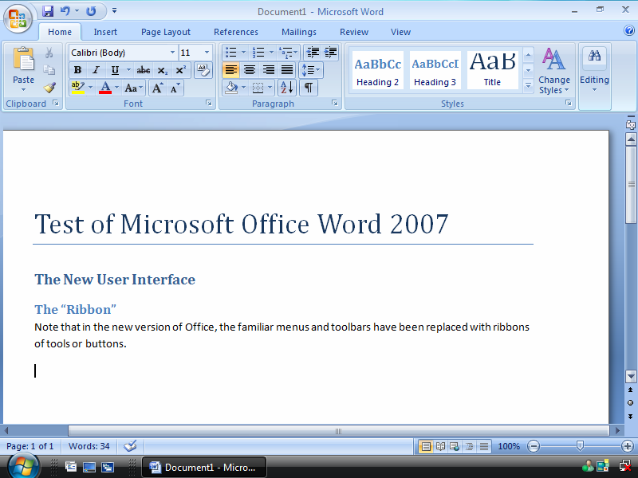

Slide 12
☞ Even Better Deal 
OpenOffice.org
  “Clone” of Microsoft Office 2003
  Free
  Not exactly the same as Microsoft Office
Notes:
Advanced Microsoft Word - Tables

Slide 13
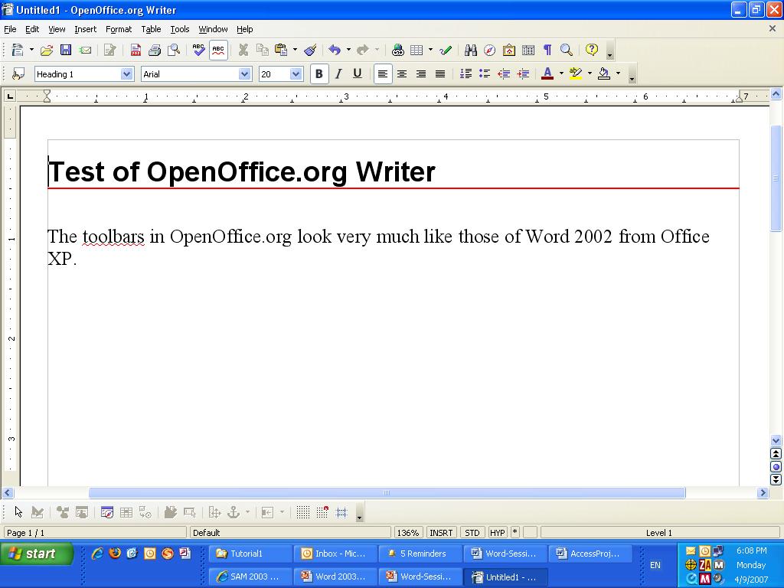

Slide 15
Learning Word
The best way to learn – use it
Use it with something important to you
  Your job
  Personal correspondence
  Work for a non-profit organization
Explore with the Help feature
Certified Microsoft Office Specialist
  For more info: www.microsoft.com/traincert/
Notes:
Advanced Microsoft Word - Tables

Slide 16
The Different Versions of Word
MS Word 97
MS Word 2000
MS Word 2002 (XP)
  Includes Smart Tags, Task Panes
MS Word 2003
  Minimal changes from 2002
MS Word 2007
  Major changes in user interface, file formats
Notes:
Advanced Microsoft Word - Tables

Slide 17
When to Use Word
Most paper-based documents
  Letters
  Simple tables
  Simple brochures and publications
Email
  Outlook usually uses Word as its editor
Electronic documents
  Simple Web pages
Notes:
Advanced Microsoft Word - Tables

Slide 18
When NOT to Use Word
Complex publications
  Instead use Microsoft Publisher, Adobe PageMaker, or Quark
Complex tables
  Use Microsoft Excel
Complex Web pages
  Use Microsoft Front Page
Notes:
Advanced Microsoft Word - Tables

Slide 19
Goals for Advanced Users
Take advantage of special features
Automate repetitive tasks
Notes:
Advanced Microsoft Word - Tables

Slide 20
Course Agenda
Tabs and Tables
Mail Merge
Graphics
Power Tips
Macros and Your Choice

Slide 21
Session 1 – Tabs & Tables
Advanced Microsoft Word
Notes:
Advanced Microsoft Word - Tables

Slide 22
Question:
How can you put one word on the left margin of a line, and another word on the right?
Like This
Tabs
Notes:
Advanced Microsoft Word - Tables

Slide 23
Things Hardly Anybody Knows
Rocket Science
Brain Surgery
Strategy for NY Knicks
How to use Tabs in Microsoft Word

Slide 24
Tabs
Traditional way to create columns
Tabs must have two components:
    Tab Characters
    Tab Stops
Notes:
Advanced Microsoft Word - Tables

Slide 25
Secret: How to Use Tabs
Type tab characters in text
Select lines of text
Set which type of tab stop you want
Insert tab stops on ruler w/ mouse
To edit the tab stop, just double-click it

Slide 26

Tab Chars & Tab Stops
Center Tab Stop
Decimal Tab Stop
Left Tab Stop
Right Tab Stop
Tab Button
Default Tab Stop
Tab Character
Ruler

Slide 27
Tab Characters
Special non-printing characters ( → )
To create:
Press Tab key on keyboard
To view:
Press Show/Hide button ( ¶ )

Slide 28
Tab Stops
Indicated on Ruler ( View / Ruler )
Can be different for each paragraph
Types of Tab Stops:
  Left
  Center
  Decimal
  Right

Slide 29
Setting a Tab Stop
Select paragraphs
Click tab button to select type of Tab Stop
(Left, Center, Right, etc.)
Click ruler where you want the Tab Stop
Repeat process for next tab

Slide 30
Adjusting Tabs
Select paragraphs
Use mouse to move tab stops on ruler
Be careful not to insert new tabs, or delete existing tabs

Slide 31
Editing a Tab Stop
Select paragraphs
Click Page Layout > Paragraph Dialog Box Launcher > Tabs
Select Tab Stop you want to change
Choose type (Left, Center, Right, etc.)
Choose leader if desired (e.g., ………)
Press Set button
Repeat process for next tab

Slide 33
Is There a Better Way to Present This Information?
ISDN requires an installation charge of $600 and costs $55 per month. DSL requires an installation charge of $600 and costs $80 per month. T1 requires an installation charge of $4000 and costs $1500 per month.
Use a Table

Slide 34
When Do You Use a Table?
Type of Connection | Installation Cost | Monthly Charge
ISDN | $600 | $55
DSL | $600 | $80
T1 | $4000 | $1500
When you have similar data

Slide 35
Tables
The better way to create short columns of text

Slide 36



Diagram of a Table
Column
ID
Name
Zip
1
Steve
10923
2
Hillary
10934
Row
3
Joan
10723
Cell
Notes:
Advanced Microsoft Word - Tables

Slide 37
What Is a Table?
Information organized by rows and columns
Columns are sometimes called "fields"
Each piece of information is a Cell
Notes:
Advanced Microsoft Word - Tables

Slide 38
Why Use Tables?
Present similar data concisely
Avoids repetition
Enables special formatting
Can do simple calculations
Notes:
Advanced Microsoft Word - Tables

Slide 39
Disadvantages of Word Tables
Limited features compared to Excel
Limited calculating power
If you need large tables, use Excel instead

Slide 40
Word Tables vs. Excel Tables
Word is better for:
  Text tables
  Tables within text documents
Excel is better for:
  Tables consisting mainly of numbers
  Tables with many calculations
  Large tables
Notes:
Advanced Microsoft Word - Tables

Slide 41
Creating a Table
Place cursor where table should appear
Click Insert > Table
Enter data into each cell
Use Tab key to go to cell at right
At end of table, Tab adds new row
Notes:
Advanced Microsoft Word - Tables

Slide 42
Converting to a Table
Select a tabular text organized with tabs
Click Insert > Table > Convert Text
Be sure that text separator is Tab
Check for correct number of columns
Notes:
Advanced Microsoft Word - Tables

Slide 43
Moving & Resizing a Table
Handles appear when pointer moves over table
  The Move handle (upper left)
  The Resize handle (lower right)
Move cursor over vertical border to reveal column-width handle
The same occurs for row-height handles
Also, use the Table Tools > Layout ribbon
  Click the arrow buttons in the Cell Size area
Notes:
Advanced Microsoft Word - Tables

Slide 44
Fast Formats for Tables
Select any cell in a table
Select the Table Tools > Design ribbon
Choose desired Table Style
Notes:
Advanced Microsoft Word - Tables

Slide 45
Table Borders
Borders are useful for highlighting cells
To use:
  Select cells that require borders
  Open the Table Tools > Layout ribbon
  Click the Borders button in Table Styles
Notes:
Advanced Microsoft Word - Tables

Slide 46
Special Table Properties
Adjust text alignment within cells
Vertical and/or horizontal alignment
To use:
  Select cells that require alignment
  Right-click one of the cells
  Choose Cell Alignment option
Notes:
Advanced Microsoft Word - Tables

Slide 47
Tabs and Tables
In Tables, Tabs provide special indentation
But — you cannot use the Tab key
Instead type Ctrl Tab
With ruler, you can also set hanging indents
Notes:
Advanced Microsoft Word - Tables

Slide 48
Sorting Table Rows
Select rows that you want to sort
Select Table Tools > Layout > Sort
Choose column by which you want to sort
Notes:
Advanced Microsoft Word - Tables

Slide 49
Exporting & Importing Tables
Select and copy Word table
Then paste into Excel worksheet
Or,
Select and copy Excel table
Then paste directly into Word document
Notes:
Advanced Microsoft Word - Tables

Slide 50
Calculations
Select cell where you want Sum
Click Table Tools > Layout > Formula
Check the Formula dialog box, click OK
NOTE: If the numbers in the table change, the formulas have to be updated:
  Right-click the sum or average
  Select Update Field
Notes:
Advanced Microsoft Word - Tables

Slide 51
Common Formulas
=SUM(ABOVE) — Adds up column of numbers immediately above
=SUM(LEFT) — Adds up row of numbers immediately to the left
=AVERAGE(ABOVE) — Averages the column of numbers immediately above
=AVERAGE(LEFT) — Averages the row of numbers immediately to the left
Notes:
Advanced Microsoft Word - Tables

Slide 52
Review
Create table or convert text to table
Move and resize tables
Format tables
Adjusting table borders
Special table properties
Notes:
Advanced Microsoft Word - Tables

Slide 53
Review (cont.)
Using the Table Menu & Table Toolbar
Using tabs in Tables
Sorting tables
Exporting and importing tables
Adding formulas to tables
Notes:
Advanced Microsoft Word - Tables

